Slide 1
Bird Sounds Recognition
WEI HUANG

Slide 2
Classification Problem
Bird sounds can be divided in songs and calls.
Songs are more melodious and are related to mating
Calls are short and transient sounds used in alert situations
Bird songs and calls are considered by experts as ideal for species identification.

Slide 3
Vocalizations of Birds
Data Collection
16 bit wave format and GOOD SNR (min, median, max)
Frequency Track Extraction (FTE) Algorithm
Transforms a time series into a spectrogram
Using T – Time, F – Frequency, A – Amplitude
Segment Calculation

Slide 4
How?
Creating in a track file.
Separating the track sets and feasible sets
Dividing the feasible sets into disjoint harmonically related subsets maximal sets
Each maximal set is compared with the vocalization models

Slide 5
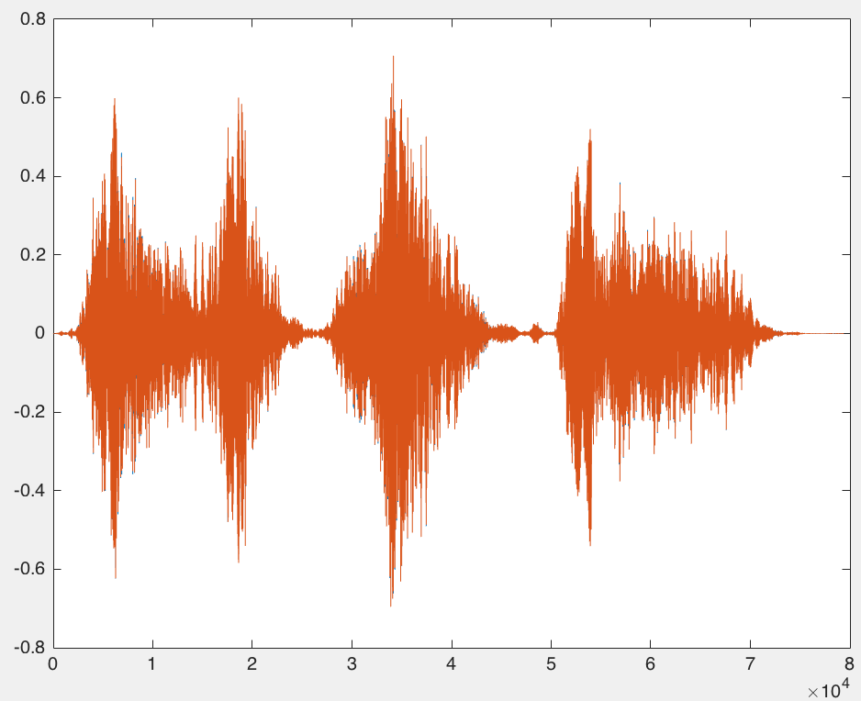
Data has Collection

Slide 6
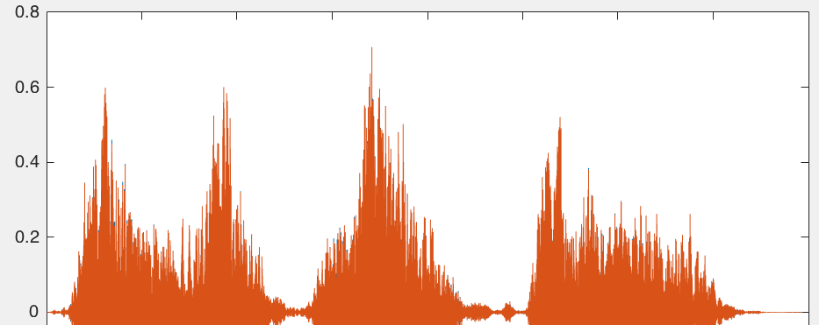
Created New Data

Slide 7
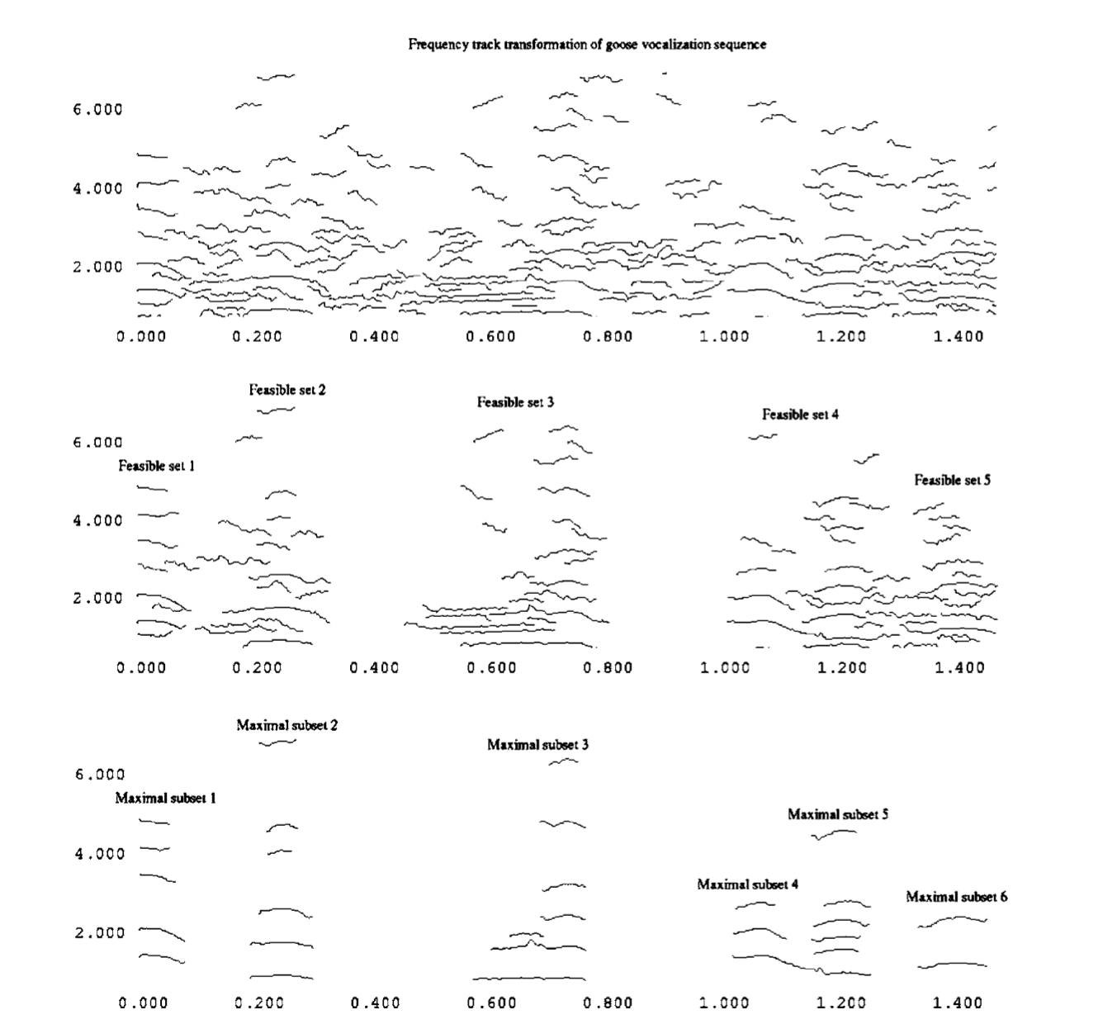

Slide 8
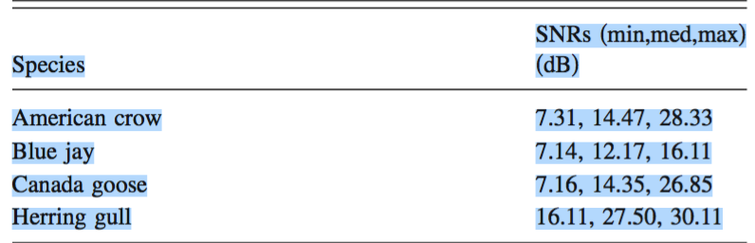
SNR Data in Training Set and Test Set

Slide 9
QUESTION?

Slide 10
REFERENCE
Heller, Jason R., and John D. Pinezich. "Automatic Recognition Of Harmonic Bird Sounds Using A Frequency Track Extraction Algorithm." Journal Of The Acoustical Society Of America 124.3 (2008): 1830-1837. Academic Search Complete. Web. 30 Nov. 2015.
Thiago L.F. Evangelista, Thales M. Priolli, Carlos N. Silla Jr, Bruno A. Angelico, Celso A.A. Kaestner, "Automatic Segmentation of Audio Signals for Bird Species Identification.” IEEE International Symposium on Multimedia (ISM) 2014. Web. 30 Nov. 2015.

